Slide 1
Program Review
Mrs. Quick

Slide 2
On an anchor point, what are the handles used for?
Adjusting the line’s curve

Slide 3
What key can a designer hold down in order maintain proportions on an object in Illustrator?
Shift

Slide 4
When a design uses a rectangular shape to cut out a smaller image of a larger photograph.
Crop

Slide 5
What is the act of spreading letters apart so there is more space in between characters?
Kerning

Slide 6
What is the increase of space between horizontal rows of type called?
Leading

Slide 7
How many points are in an inch?
72

Slide 8
A company with a long name may choose to abbreviate their name by using this type of mark:
Lettermark

Slide 9
What is a lettermark?
A logo that relies on the letters of the brand

Slide 10
Which file type is best suited for logo design?
Vector

Slide 11
What is the first step in creating a design?
Research

Slide 12
What is a good question to ask yourself while researching?
Who is the target market?
Who are the competitors?
What is the industry like as a whole?

Slide 13
Which of these is not a consideration when targeting a specific audience?
Personal taste

Slide 14
This type of printing uses a screen to transfer images onto a substrate (tshirt, poster, etc).
Screen printing

Slide 15
What is the best way to develop multiple design ideas?
Thumbnails

Slide 16
What is the next step after you have created your thumbnail?
Roughs

Slide 17
What is the term for using someone else's artwork without permission?
Appropriation

Slide 18
What is the term used for when designer creates a consistent visual identity for a business
Branding

Slide 19
In order to ensure consistency of color use, a designer can save sample colors, known as:
Swatches

Slide 20
When Nike creates a new product for females, that group of athletes is considered to be the:
Target Audience

Slide 21
What is an example of unity?
When a shoe and its box use a matching color scheme

Slide 22
Which color mode should be used when creating imagery that is to be used on a webpage?
RGB

Slide 23
Which color mode should be used when creating an image for output at a commercial printer?
CMYK

Slide 24
In pixels per inch (PPI), what should resolution be set at for use on the internet?
72

Slide 25
In dots per inch (DPI), what should resolution be set at for printing a photograph?
300

Slide 26
What color mode can display only a very limited range of the grey?
Grayscale

Slide 27
Product, label and color scheme are all aspects that a designer should consider when creating:
Package Design

Slide 28
When a designer of dolls attempts to appeal to young children, they are giving consideration to
Target Audience

Slide 29
What is the white space on the outer edges of a design that supports the rest of the design?
Margins

Slide 30
What does PPI stand for?
Pixels per inch

Slide 31
What does DPI stand for?
Dots per inch

Slide 32
This term refers to the line of type that gives the name of the publication
Masthead

Slide 33
This term refers to the area found between columns of text in a page layout:
Gutter

Slide 34
Area of a page where information such as chapter/section name and page numbers are located:
Footer

Slide 35
If you want a photo to go off the edge of a page, this should be set between .125" and .25":
Bleed

Slide 36
This term refers to text that goes with a photo/illustration as a title or explanation
Caption

Slide 37
What do designers use to kick start the creative process?
Thumbnail sketches

Slide 38
What is the most important element of any design?
Craftsmanship

Slide 39
What is the importance of maintaining quality documents?
Ease of interpretation by others

Slide 40
What is the difference between art and design?
Art is self-expression and design is sending information.

Slide 41
What does not apply to design?
Self expression

Slide 42
What determines which elements are most important to least important?
Hierarchy

Slide 43
This can be manipulated by use of scale, color, contrast, etc.
Emphasis

Slide 44
Something which is visually easy to understand has achieved:
Simplicity

Slide 45
What describes the way an eye-flows through a design?
The sequence of movement

Slide 46
What are the additive colors?
RGB

Slide 47
What are the subtractive colors?
CMYK

Slide 48
What is the role of a Graphic Designer?
To persuade, inform and influence

Slide 49
What contributes to the success of a media business?
Business plan, marketing plan and financial plan

Slide 50
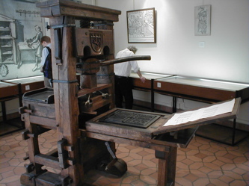
Who invented the mass printing press?
Gutenberg
It revolutionized printing.

Slide 51
What is the biggest impact of social media on the media industry?
Rapid change

Slide 52
What is viral media?
Media that is passed person to person. Typically a popular content.

Slide 53
What is the first step in launching a media business?
Business plan

Slide 54
What are the 3 phases of production?
Pre-production, production, post-production

Slide 55
When requesting a quote from a printer, what do you need to indicate?
Color, paper stock and quantity

Slide 56
What is the name of the program created to protect worker health and safety?
OSHA

Slide 57
What does ADA stand for?
Americans with Disability Act

Slide 58
What is the best source for legal imagery?
Royalty Free

Slide 59
What is a consequence for using images without permission?
Financial Loss

Slide 60
When is copyright established?
At the time of creation

Slide 61
What agency establishes copyright?
US Copyright Office

Slide 62
What is the point of having copyright?
Explicit ownership

Slide 63
What is the only way that you can use a copyrighted image without consequences?
If you are creating a parody

Slide 64
What is the benefit of a trademark?
Consistent brand identity

Slide 65
What is intellectual property?
A work or invention that is the result of creativity to which one has rights and for which one may apply for a patent, copyright, trademark, etc.

Slide 66
What is the difference between parody and inspiration?
Parody is a joke and inspiration is a design that influences your work.

Slide 67
What is fair use?
Fair Use is a legally permissible use of copyrighted material for specific purposes.

Slide 68
What is public domain?
Works who’s exclusive intellectual property has expired
Works who’s exclusive intellectual property has been forfeited
Works who’s exclusive intellectual property has been waived

Slide 69
What is typography?
The arrangement of aesthetics of letter forms.

Slide 70
What is the best way to obtain information for a project?
Interview the client

Slide 71
What are some considerations that you would take into account when practicing verbal and non-verbal communication with a client?
Their culture, background and generation.

Slide 72
What skills are exhibited when a person's focus is on the speaker and encouraging continued consideration?
Active listening, active reflection and active questioning

Slide 73
What is one formal research method?
Survey

Slide 74
What is a good way to verify the accuracy of information from your research?
Have the client review it

Slide 75
What is an example of a primary source?
Interview

Slide 76
What would be the best way to reach an audience over 65 years old?
Flyers mailed home

Slide 77
What would be the best way to reach an audience of high school students regarding graduation announcements?
Group text

Slide 78
What is a factor to consider when determining the proper format for a design piece?
Who the target audience is
Where the information will be received
The client’s brand identity

Slide 79
What should you look for when editing a design piece?
Proper grammar and sentence structure
Proper use of elements and principles
An intentional eyeflow

Slide 80
What application should be used to design an Ebook?
InDesign

Slide 81
What application should be used to create custom illustrations?
Illustrator

Slide 82
What is the key command to paste text?
CTRL+V

Slide 83
What is the key command to undo?
CTRL+Z

Slide 84
What is the key command to save?
CTRL+S

Slide 85
Why is creating project folders important?
Organization of files
Accessibility of files

Slide 86
What file format should you use when creating an image with a transparent background?
PNG

Slide 87
What is the importance of taking proper care of your equipment?
Longevity

Slide 88
What is an example of intranet?
a private network accessible only to an organization's staff.

Slide 89
What are some examples of computer threats?
Virus
Phishing
Hacking

Slide 90
What is the best software to scan an image?
Photoshop

Slide 91
What is the best software to manipulate an image?
Photoshop

Slide 92
What is the proper resolution to scan a printed brochure?
300 PPI

Slide 93
What hardware would you use to capture and transfer a pencil sketch to a computer?
Flatbed Scanner

Slide 94
What is an SD card used for?
Data storage

Slide 95
What is the best way to backup a file?
Offsite storage

Slide 96
What does not apply to design?
Self-expression

Slide 97
What is design predominately used for?
Communication

Slide 98
Balance, emphasis, movement, unity, contrast and simplicity are examples of what?
Principles of design

Slide 99
Line, shape, space, color, typography and texture are examples of what?
Elements of design

Slide 100
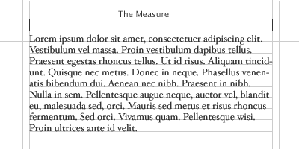
Body Type
Body Type
Classic size is 10 point
Also traditionally 9, 11, and 12 points
Used for large blocks of text
Enables reader to read easily

Slide 101
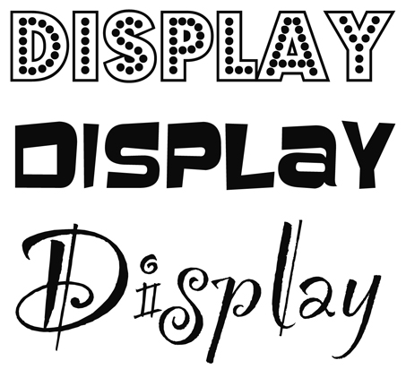
Display Fonts
Display Type
Larger type, 18 points and above
18, 24, 30, 36, 48, 60, 72
Used in display pieces (posters, flyers, covers)
Also used in titles, headlines, and headings
Mrs. Quick is a Great Teacher! = 28 pts bold
Mrs. Quick is a Great Teacher!
= 18 pts bold

Slide 102
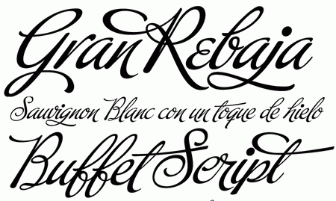
Script Fonts
Script Typefaces
Based upon the varied and often fluid stroke created by handwriting.

Slide 103
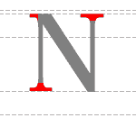
Serif Fonts
Serifs are the finishing strokes at the top and bottom of a letter

Slide 104
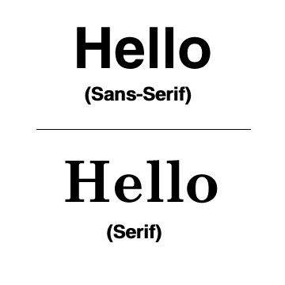
Sans Serif Font
Sans means “without” serifs
Plain, unadorned letters

Slide 105
What is used to lighten color?
Tint

Slide 106
What is used to darken color?
Shade

Slide 107
What color mode/gamut is used on a screen?
RGB

Slide 108
What color mode/gamut is used for printing?
CMYK

Slide 109
What is the most important consideration when developing a color scheme?
Target Audience

Slide 110
What are two common color combinations that are said to stimulate hunger?
Red and Yellow

Slide 111
What color represents calmness?
Blue

Slide 112
What color represents anger?
Red

Slide 113
Which file type can be scaled up without the loss of resolution?
EPS

Slide 114
What are raster files best suited for?
Image manipulation

Slide 115
What is another term for raster?
Bitmap

Slide 116
What are vectors made up of?
Lines and anchors

Slide 117
What is the first step in creating a design?
Research

Slide 118
What is not a consideration when targeting a specific audience?
Personal taste

Slide 119
What are important questions to ask when researching for a design?
Who is your target market?
Who are the competitors?
What is the industry like as a whole?

Slide 120
What are the parts of a design workflow (creative process)?
Research, design, concept and proposal

Slide 121
What are several considerations you would think about when targeting a specific audience?
Culture, diversity, moral ethics and demographics

Slide 122
What is a benefit of DSLR cameras?
Interchangeable lenses

Slide 123
What accessory controls external flash on a DSLR camera?
Hotshoe

Slide 124
What is the best format for a web image?
JPG

Slide 125
What file type is uncompressed and unedited?
RAW

Slide 126
Which file type is black and white?
BMP

Slide 127
TIFF file type
High quality
Higher quality than GIF or JPG

Slide 128
What is the best application for high gloss coated paper?
Book Cover

Slide 129
What is the biggest benefit of maximizing space on a design?
Avoiding waste

Slide 130
What software is the industry standard for photo manipulation?
Photoshop

Slide 131
What software is industry standard for vector images?
Illustrator

Slide 132
What software is industry standard for multi-page layouts?
InDesign

Slide 133
What does WYSIWYG stand for?
What you see is what you get

Slide 134
What is the best way to develop multiple design ideas?
Thumbnails

Slide 135
What design principle determines the visual unity of a piece?
Balance

Slide 136
What is the best color pallet for a print piece?
PMS

Slide 137
What is the standard range for greyscale?
10

Slide 138
What is grayscale?
The color mode that is limited to a range of values between black and white

Slide 139
What is the best panel to use when manipulating multiple objects on a project?
Layers

Slide 140
What is a swatch?
A combination of colors

Slide 141
What colors images in Illustrator?
Fill/stroke

Slide 142
This allows you to manipulate the opacity of a layer. It is non-destructive
Layer mask

Slide 143
This tool allows you to select objects in Illustrator.
Selection tool

Slide 144
This tool allows you to select anchor points in Illustrator.
Direct selection tool

Slide 145
This tool allows you to sample colors
Eye dropper tool

Slide 146
What is the eyedropper tool used for?
Sampling color

Slide 147
What is the purpose of a layer mask?
Non-descructively removes parts of a layer

Slide 148
What would be the best size of a document for a 5x7 postcard with a full bleed?
5.25x7.25

Slide 149
What is the appropriate alignment for a large picture on the left side and type on the right side of a document?
Align right

Slide 150
What is the purpose of a tripod?
Outdoor shoot

Slide 151
What is the best format to upload a brochure to the web?
PDF

Slide 152
What is the most critical component of a product revision?
Client feedback

Slide 153
What is most important when comparing a screen image and a print image?
Adequate lighting

Slide 154
What is used to evaluate products for a target market?
Focus group

Slide 155
What is a critical component when an item needs a large scale revision?
Brainstorming

Slide 156
If you have various brochures, what would you show the client?
Mockup

Slide 157
What term is used for showing a client various types of brochures?
Mock up

Slide 158
What is included in the completion phase of the creative process?
Preflight

Slide 159
What is the format used in a professional printed piece?
TIFF

Slide 160
Which color system would you specify in graphic software for printing a color design?
CMYK

Slide 161
What is preflighting?
Process when preparing and reviewing a document for print

Slide 162
What is the step prior to sending a publication to the printer?
Package

Slide 163
What should be included when packaging a file?
Instructions, a folder of links, a folder of fonts and the native file

Slide 164
What kind of binding is used for a large textbook?
Saddle stitching

Slide 165
What consideration would you have for loading an image to the internet?
Download speed

Slide 166
What is checked on a printer proof?
Paper trim and accuracy

Slide 167
What is the biggest factor that slows down work production?
Employee absences

Slide 168
What is the importance of "dressing for success"?
Creates a good first impression

Slide 169
Online Portfolio
Behance.com

Slide 170
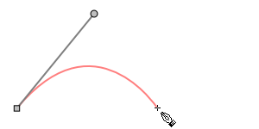
Bezier Curve

