Slide 1
The Principles of Graphic Design
Graphic Design II

Slide 2
What are the Principles of Design?
Balance
Emphasis
Movement
Unity
Contrast
Simplicity
The principles of design are how one incorporates the elements of design in an artwork.

Slide 3
Balance
The distribution of the visual weight of objects, colors, texture, and space. If the design was a scale, these elements should be balanced to make a design feel stable.
In symmetrical balance, the elements used on one side of the design are similar to those on the other side; in asymmetrical balance, the sides are different but still look balanced. In radial balance, the elements are arranged around a central point and may be similar.

Slide 5
Emphasis
The part of the design that catches the viewer’s attention.
Usually the designer will make one area stand out by contrasting it with other areas. The area could be different in size, color, texture, shape, etc.

Slide 6
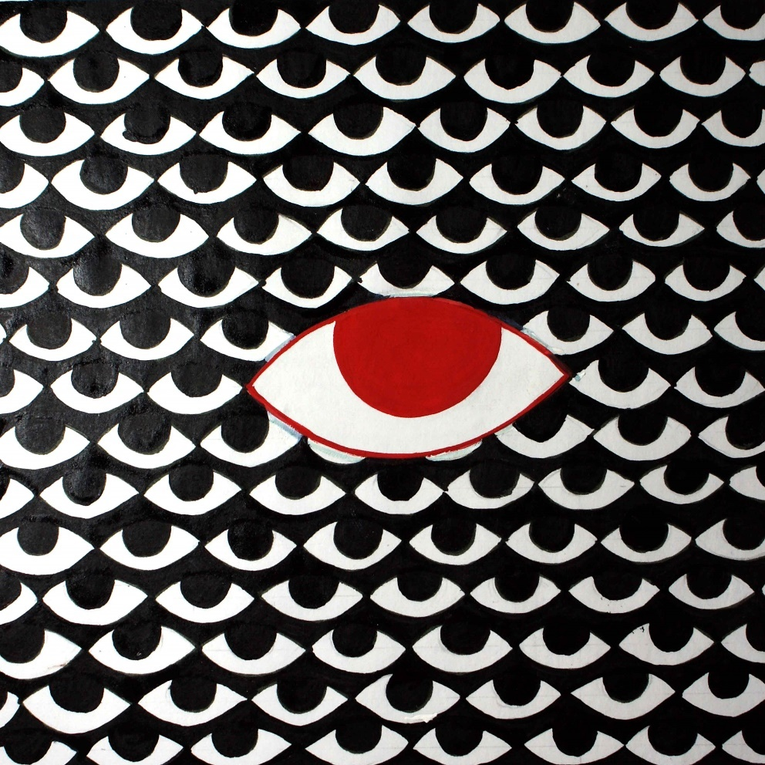

Slide 7
Movement
The path the viewer’s eye takes through the work of design, often to focal areas.
Such movement can be directed along lines, edges, shape, and color within the design. Movement is closely tied with rhythm.
Sequence of Movement is the way the viewer’s eye flows through a design.

Slide 8
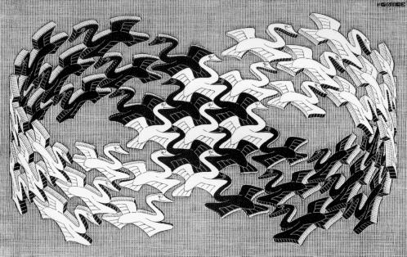

Slide 9
Unity
The feeling of harmony between all parts of the design, which creates a sense of completeness.
Unity creates an integrated image in which all the elements are working together to support the design as a whole. A unified design is greater than the sum of its parts; the design is seen as a whole first, before the individual elements are noticed

Slide 10
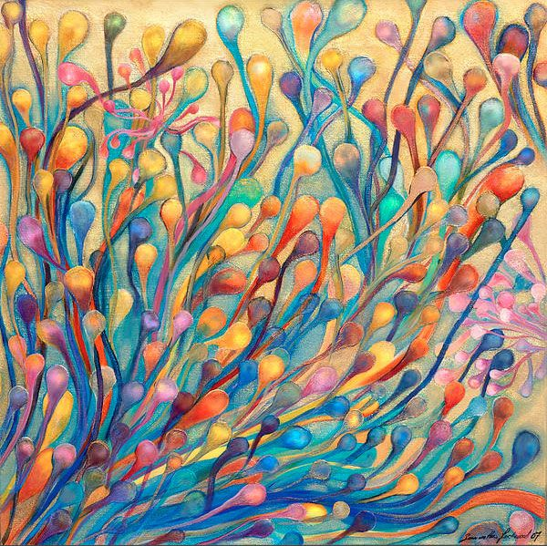

Slide 11
Contrast
The arrangement of opposite elements (light vs. dark colors, rough vs. smooth textures, large vs. small shapes, etc.) in a piece so as to create visual interest, excitement and drama.
Contrast can work with any design element. For example, if you have a group of lines that are all the same size, there is no contrast. But if one is a lot longer than the others, it contrasts with them.

Slide 13
Simplicity
The freedom from complexity, intricacy, or division into parts. Absence of pretentiousness or ornament and directness of expression.
Simplicity is about subtracting the obvious and adding the meaningful. It’s about making something easier to understand.

Slide 14
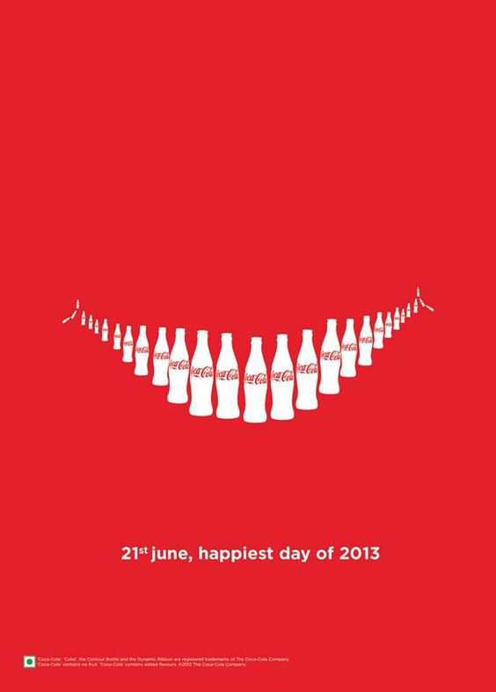

Slide 15
Key Terms
Logo
A symbol or other design adopted by an organization to identify its products, uniform, vehicles, etc.
Border
An outer part or edge.
Tagline
A catchphrase or slogan, especially as used in advertising, or the punch line of a joke.

